Slide 1


TO LEAVE or NOT TO LEAVE THAT IS THE QUESTION! (Understanding and predicting the triggers for Employee Turnover)
Presented by the Engagement, Motivation, Cheerleading (EMC) Team:
Gabrielle Bedewi, Todd Petruska, Nandini Tivakaran
October 2, 2023

Slide 2
Topics
Background
Objective and Data Source
Analysis Steps
Exploratory Analysis Insights
Interactive Visualization of Insights
Predictive Analytics Insights
Limitations, Challenges, and Further Analysis Recommendations
Q & A
Appendix

Slide 3
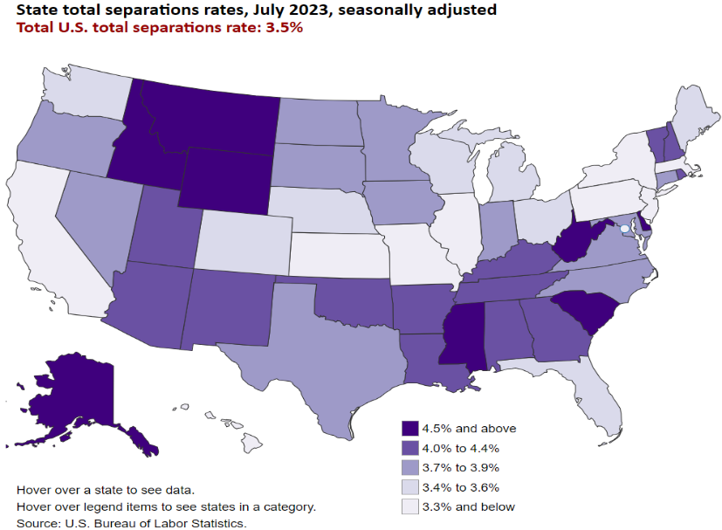
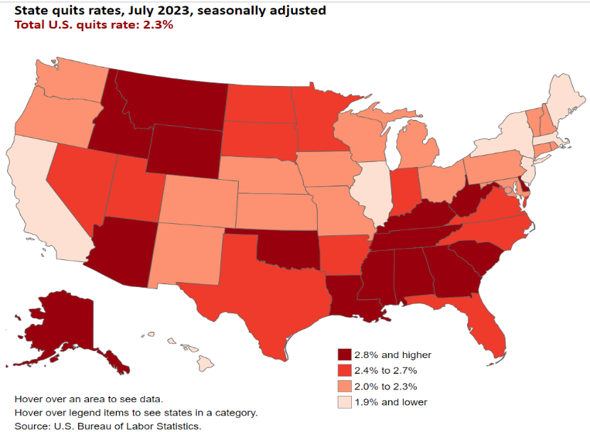
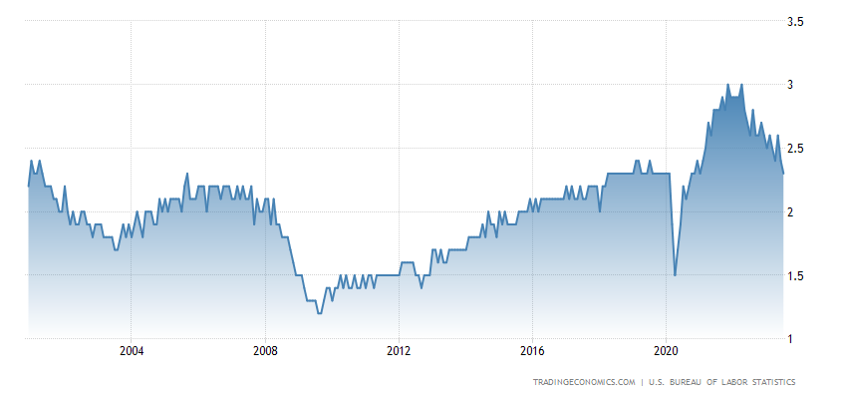
The Current State of the Labor Market – July 2023 (after the Pandemic)
Separations include “voluntary” (quitting and retiring) and “involuntary” (layoff and termination) employee attrition.
Job quit rates in the United States averaged 2.00% from 2000 until 2023, reaching an all time high of 3.00% in November of 2021 and a record low of 1.20% in August of 2009.

Slide 4
It is time-consuming and expensive to find, interview, and hire new employees; therefore, increasing employee retention is advantageous to employers.
Data Source - https://www.kaggle.com/code/keithvincentburca/salifort-motors-hr-analytics/notebook
The HR department at Salifort Motors, a fictional French-based alternative energy vehicle manufacturer, wished to initiate programs for improving employee satisfaction levels at the company.
To understand “what’s likely to make the employee leave the company?”, the goal of this project is aimed to analyze the HR data about 14,999 employees for insights and recommendations to improve employee retention.
The initial CSV file included the following variables:
Target variable: “left” - Employee Left the Company (yes=1, no=0)
Possible features (variables) for consideration:
“satisfaction_level” – Employee-reported job satisfaction level (value between 0 and 1)
“last_evaluation” – Average score of employee’s last performance review (value between 0 and 1)
“number_project” – Number of projects employee contributes to
“average_monthly_hours” – Average number of hours employee worked per month
“time_spent_company” – Number of years (tenure) employee has been with the company
“work_accident” – Whether an employee experienced an accident while at work (yes=1, no-0)
“promotion_last_5years” – Whether an employee was promoted in the last 5 years (yes=1, no=0)
“department” – Employee’s department (one of 10 departments)
“salary” – Employee’s salary level (categories - low $/medium $/high $)

Slide 5
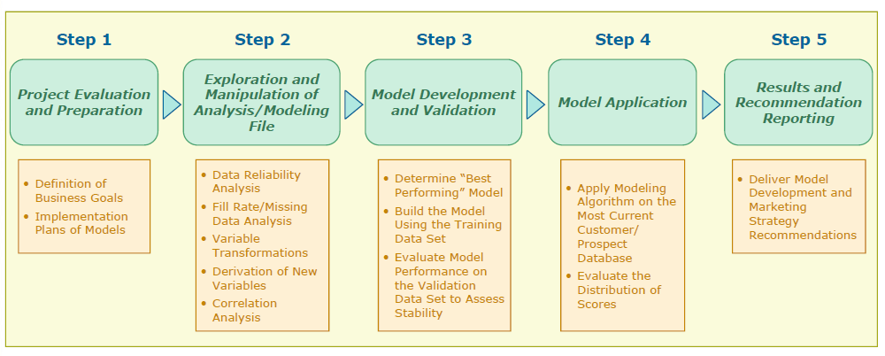
Analysis Steps
The 5-step process for the development & application of a predictive model

Slide 6
Exploratory Analysis Insights

Slide 7
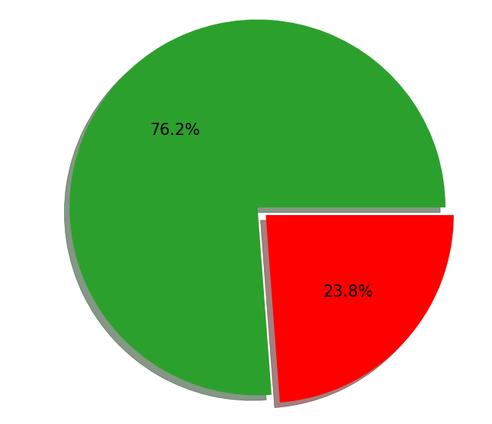
Overview of Employee Turnover
23.8% of the employees at Salifort Motors decided to leave last year.
# of employees who stayed is 11,428
# of employees who left is 3,571

Slide 8
Correlation Analysis Matrix (Relationship Overview)

Slide 9
Overview of Employee Turnover (Satisfaction Score)
The highest attrition rates, at 67.5% and 51.3%, occur at the Poor and Very Poor satisfaction levels; respectively.
The lowest attrition rate, at 4.6%, occurs at the Average satisfaction rate.
Employees at the Excellent satisfaction level, have the 3rd attrition rate of 13.2%.
Among the employee who quit the company, the highest percentage of departures occurs at the Poor satisfaction level. (denominator is total number of employees who quit – 3571)

Slide 10
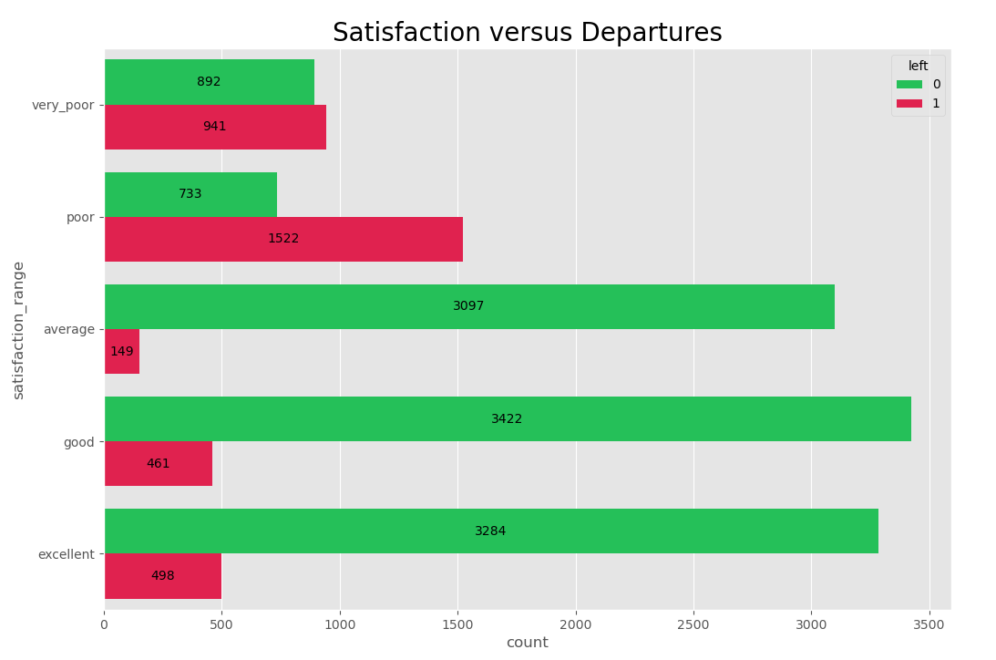
Overview of Employee Turnover (Satisfaction Score)
satisfaction_range | 0 | 1
All | 76.19% | 23.81%
very_poor | 48.66% | 51.34%
poor | 32.51% | 67.49%
average | 95.41% | 4.59%
good | 88.13% | 11.87%
excellent | 86.83% | 13.17%
Among the employees who quit the company, the highest percentage of departures occurs at the Poor satisfaction score (1,522; 67.49%) followed by Very Poor (941; 51.34%)
(denominator is total number of employees who quit – 3571)

Slide 11
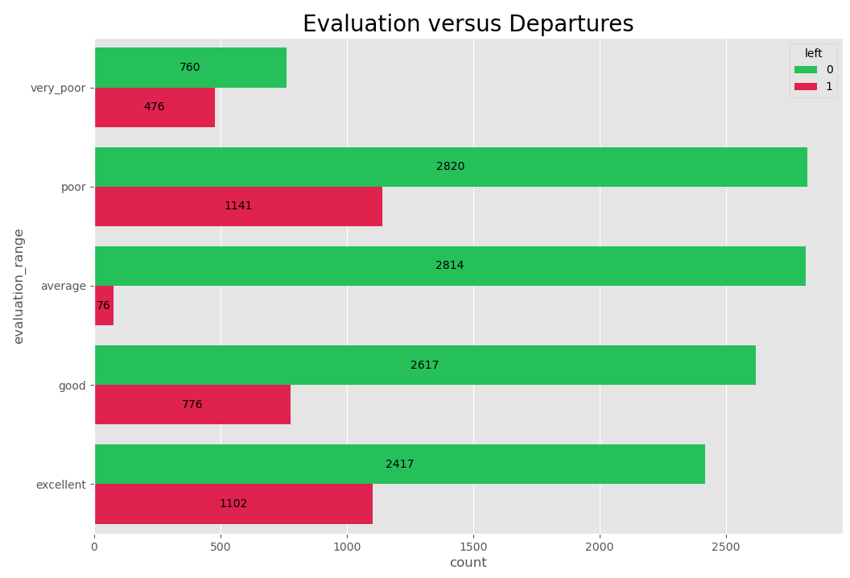
Overview of Employee Turnover (Evaluation Score)
evaluation_range | 0 | 1
All | 76.19% | 23.81%
average | 97.37% | 2.63%
very_poor | 61.49% | 38.51%
excellent | 68.68% | 31.32%
poor | 71.19% | 28.81%
good | 77.13% | 22.87%
Among the employees who quit the company, the highest percentage of departures occurs for employees with evaluation scores in the Very Poor (475; 38.51%) category followed by scores in the Excellent category (1,102; 31.32%)
(denominator is total number of employees who quit – 3571)

Slide 12
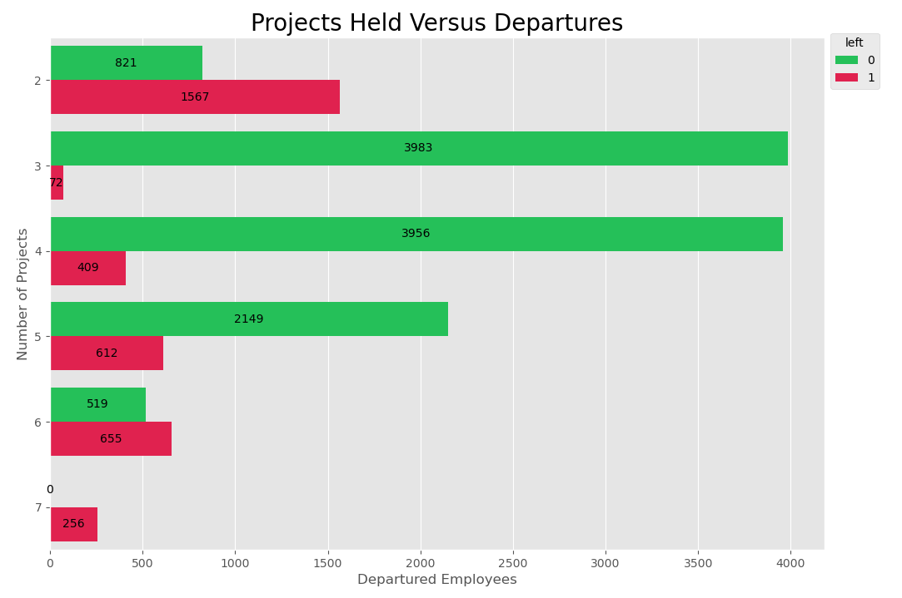
Overview of Employee Turnover (# of Projects)
# of Projects | 0 | 1
All | 76.19% | 23.81%
2 | 34.38% | 65.62%
3 | 98.22% | 1.78%
4 | 90.63% | 9.37%
5 | 77.83% | 22.17%
6 | 44.21% | 55.79%
7 | 0 | 1
Among the employees who quit the company, the highest percentage occurs for employees with seven (256; 100%) projects followed by employees with only two projects (1,567; 65.62%)
(denominator is total number of employees who quit – 3571)

Slide 13
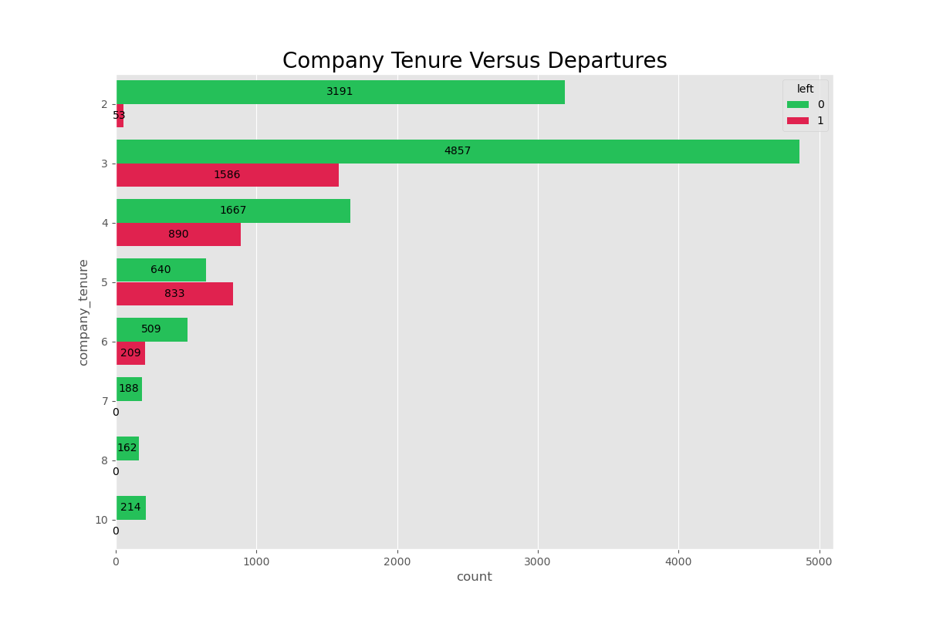
Overview of Employee Turnover (Tenure at Company)
Company_Tenure | 0 | 1
All | 76.19% | 23.81%
2 | 98.37% | 1.63%
3 | 75.38% | 24.62%
4 | 65.19% | 34.81%
5 | 43.45% | 56.55%
6 | 70.89% | 29.11%
7 | 100.00% | 0.00%
8 | 100.00% | 0.00%
10 | 100.00% | 0.00%
Among the employees who quit the company, the highest percentage of departures occurs at five years (833; 56.55%) followed by four years (890; 34.81%)
(denominator is total number of employees who quit – 3571)

Slide 14
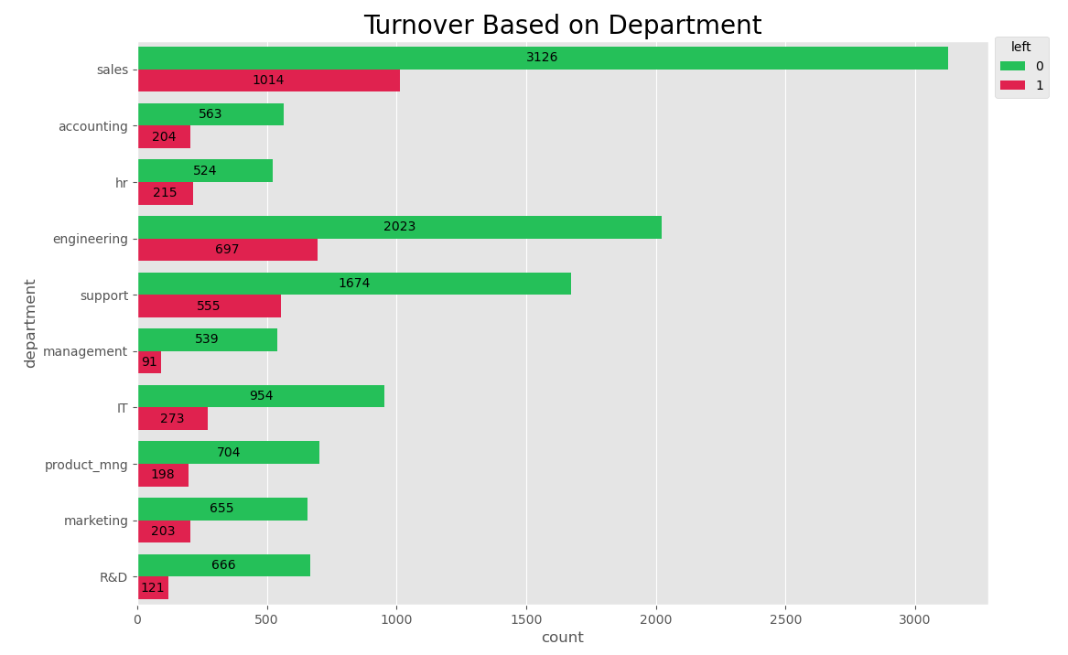
Overview of Employee Turnover (Department)
Department | 0 | 1
All | 76.19% | 23.81%
IT | 77.75% | 22.25%
R&D | 84.63% | 15.37%
accounting | 73.40% | 26.60%
engineering | 74.38% | 25.63%
hr | 70.91% | 29.09%
management | 85.56% | 14.44%
marketing | 76.34% | 23.66%
product_mng | 78.05% | 21.95%
sales | 75.51% | 24.49%
support | 75.10% | 24.90%
Among the employees who quit the company, the highest number of departures occurs Sales department (1,014; 24.49%); however, the overall highest percentage of departures occurred in the HR department with (215; 29.09%), followed by Accounting with (204, 26.60% departure rate
(denominator is total number of employees who quit – 3571)

Slide 15
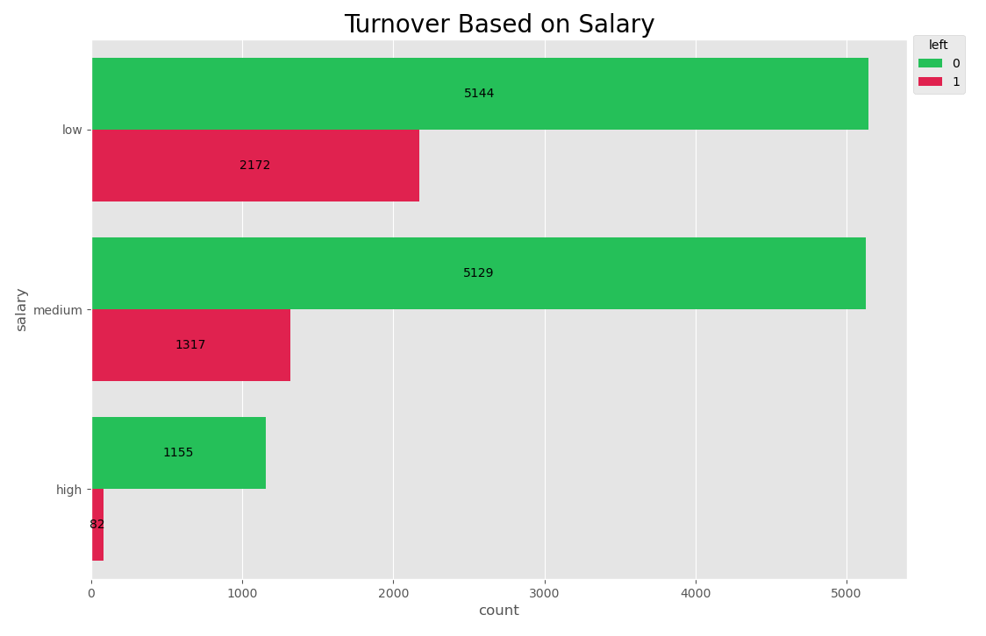
Overview of Employee Turnover (Salary)
Salary | 0 | 1
medium | 79.55% | 20.45%
low | 85.38% | 14.62%
high | 95.15% | 4.85%
Among the employees who quit the company, the highest percentage of departures occurs for salaries in the Medium category (1,317; 20.45%) followed by the Low category (2,172; 14.62%)
(denominator is total number of employees who quit – 3571)

Slide 16
Interactive Visualization of Insights (Tableau Demo)
https://public.tableau.com/views/EmployeeTurnoveratSalifortMotors/EmployeeTurnoveratSalifortMotors?:language=en-US&publish=yes&:display_count=n&:origin=viz_share_link

Slide 17
Predictive Analytics Insights

Slide 18
Predictive Analytics Insights Compare and Contrast Model Performance
Random Forest model outperformed the other 3 predictive models in the consideration set.

Slide 19
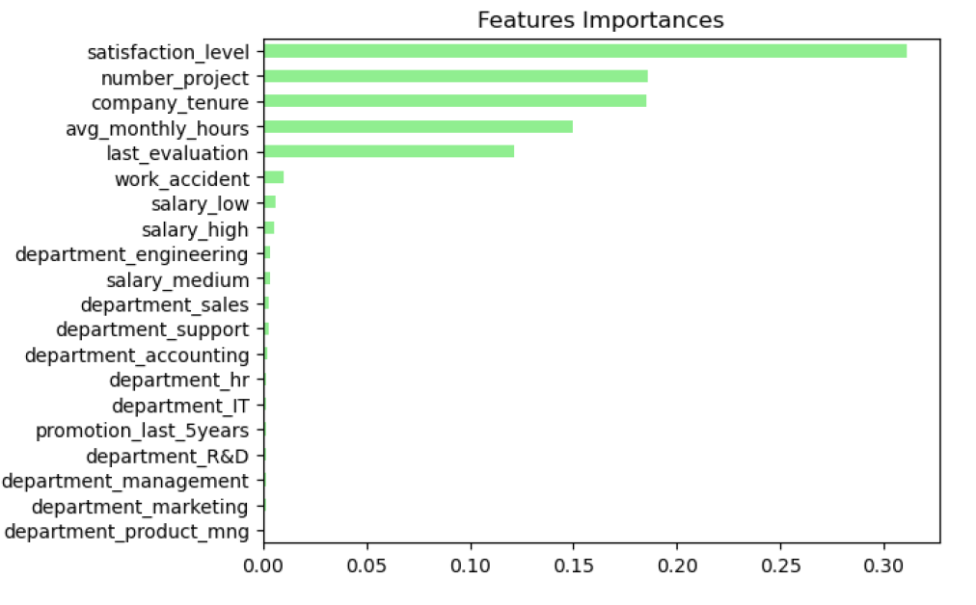
Predictive Analytics Insights Random Forest (winning) Model – Feature Importance
Recalling correlation matrix –
Less likely to leave – the higher the satisfaction level (-ve correlation coefficient).
Less likely to stay – the higher the # of projects, company tenure, average monthly hours or last evaluation score.

Slide 20
Limitations, Challenges, and Further Analysis Recommendations
Limitations:
Limited dataset context
Challenge in determining realistic bins for Satisfaction Levels, Evaluation Scores, Average Monthly Hours, etc.
Missing Employee ID in dataset
Uncertainty in handling 3,008 possible record duplicates, whether real or not!
Even though Neural Network was second best performing model, it is challenging to develop an actionable HR plan; black box when it comes to understanding importance of features.
Time constraints limited consideration of further modeling techniques and data transformation options.
Recommendations:
Exit interviews to determine reason(s) for departure; such as, promotion or retirement.
Opportunities to increase employee satisfaction, employee wellness (life-work balance). Refer to Appendix for increasing employee satisfaction.

Slide 21
Q & A

Slide 22
APPENDIX

Slide 23
19 Ways to Improve Employee Satisfaction
Recognition and Appreciation Meetings
Competitive Compensation
Employee Assistance Programs (EAPs)
Sabbaticals and Extended Leave
Pet-Friendliness
Environmental Sustainability
Flexible Schedules
Employees Milestone Celebrations
Corporate Bulletin
Feedback (timely and frequent)
Learning Opportunities
Open Dialogue and Transparency
Employee Wellness Initiatives
Regular Social Interactions
Good Working Conditions
“Think Tank” Innovation Sessions
Clear Career Paths
A Robust Social Culture
Minimal Bureaucracy
https://teambuilding.com/blog/improve-employee-satisfaction

